Slide 1
Transducer Engagement
Rose Tavary
Sr. Mechanical Engineer

Slide 2
Objective
Review Interactions Occurring in Solid-Solid Mixing
Influence of Headspace on Mixing Power and Scaling
Transducer transfers energy from one type to another
Top Transducer
Headspace
Bottom Transducer
Bed
Height

Slide 3
Comparing Elastic vs Inelastic Particles
Elastic Collisions
  Kinetic Energy Transferred Between Colliding Particles
Inelastic Collisions
  Kinetic Energy Transformed By Particles

Slide 4
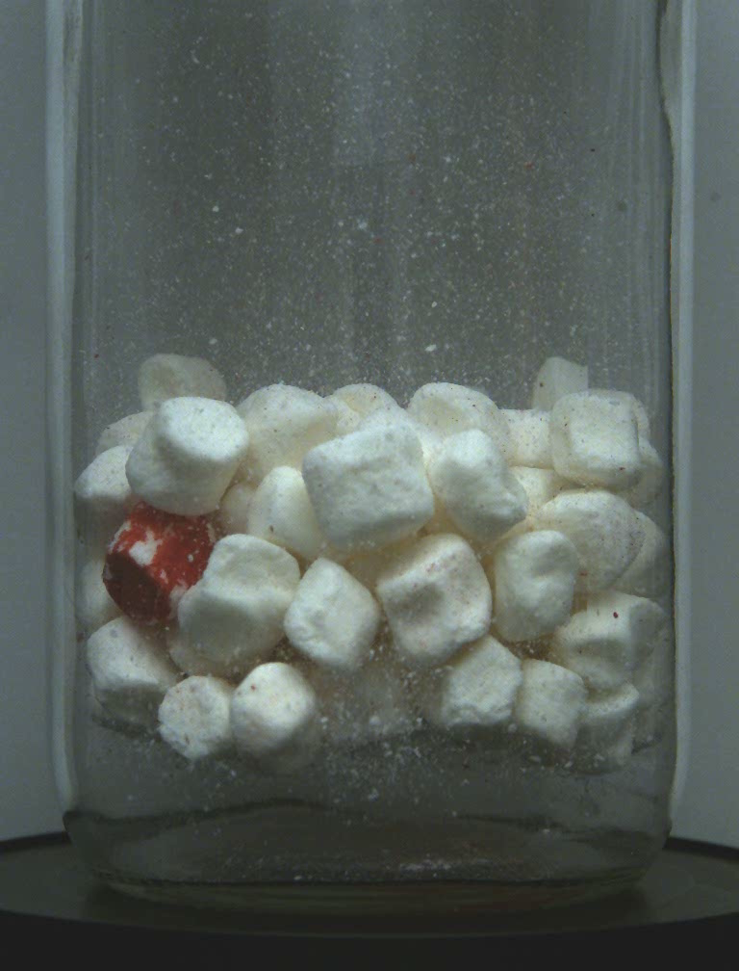
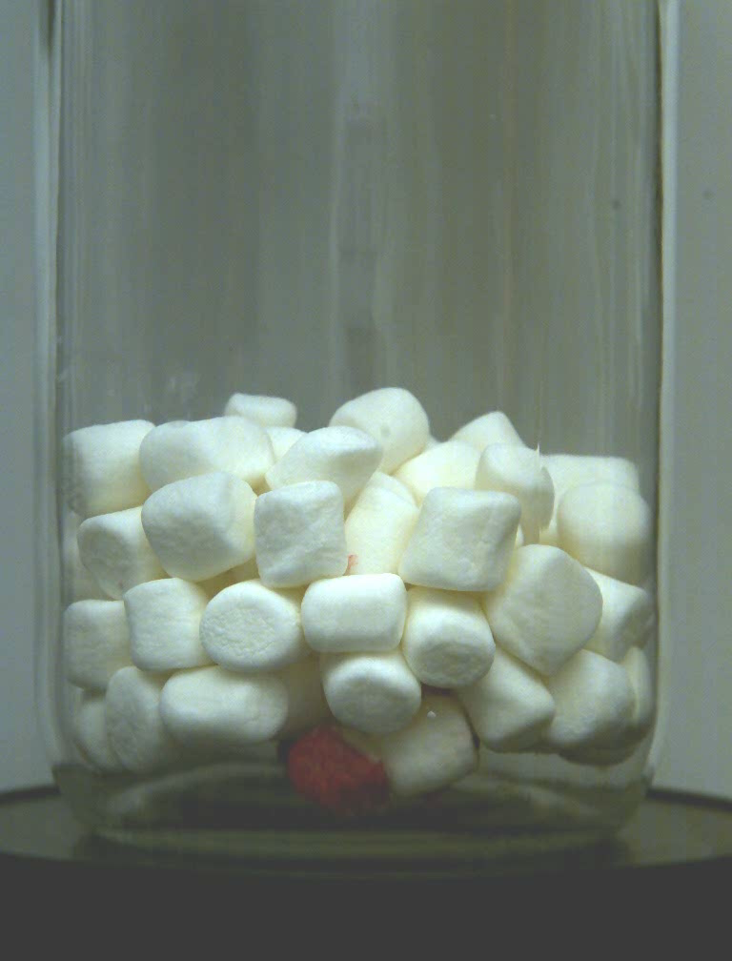
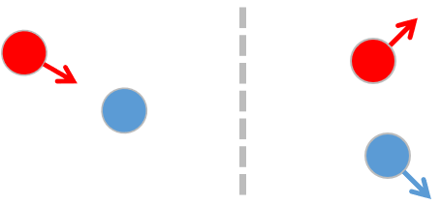
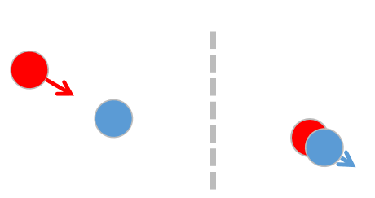
Comparing Elastic vs Inelastic Particles
Elastic Marshmallows
at 90g
Inelastic Marshmallows
at 90g

Slide 5
Dual Transducer Theory
Elastic Powder RAM Mixing
Large Headspace
Reduced Headspace
.7”
2.7”
2.9”
0.5”

Slide 6
Dual Transducer Theory
Elastic Powder RAM Mixing
  Solid Particle Collisions are Initiated by the Vessel’s Transducers
Large Headspace
Reduced Headspace
100g RAM Acceleration
100g RAM Acceleration
100g RAM Acceleration

Slide 7
Dual Transducer Theory
Elastic Powder RAM Mixing
  Solid Particle Collisions are Initiated by the Vessel’s Transducers
Large Headspace
Reduced Headspace
100g RAM Acceleration
1g Gravity
100g RAM Acceleration
100g RAM Acceleration

Slide 8
Dual Transducer Theory
Elastic Powder RAM Mixing
  Solid Particle Collisions are Initiated by the Vessel’s Transducers
Large Headspace
Reduced Headspace
100g RAM Acceleration
1g Gravity
100g RAM Acceleration
100g RAM Acceleration

Slide 9
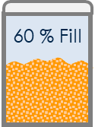
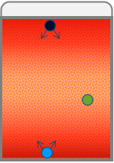
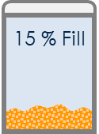
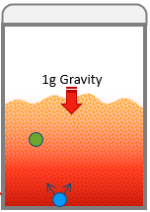
Headspace In Practice – Elastic Particles
Engagement with the Second Transducer is Affected by Adjusting Acceleration and Headspace
Reduced
Headspace
Power Density Increase From Engaging Both Transducers
Large
Headspace

Slide 10
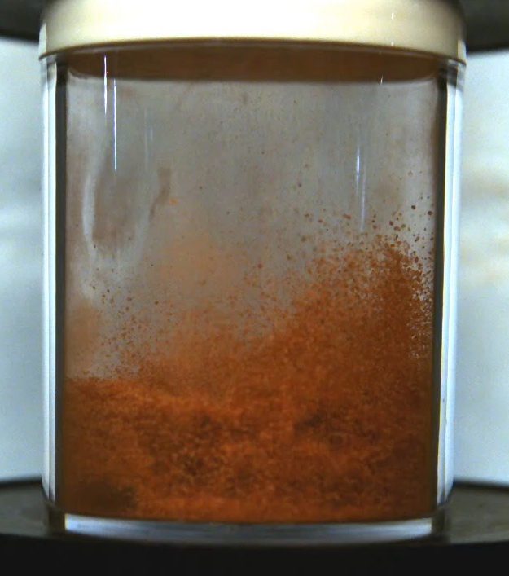
Headspace In Practice – Elastic Particles
Engagement with the Second Transducer is Affected by Adjusting Acceleration and Headspace
Reduced
Headspace
Power Density Increase From Engaging Both Transducers
Large
Headspace

Slide 11
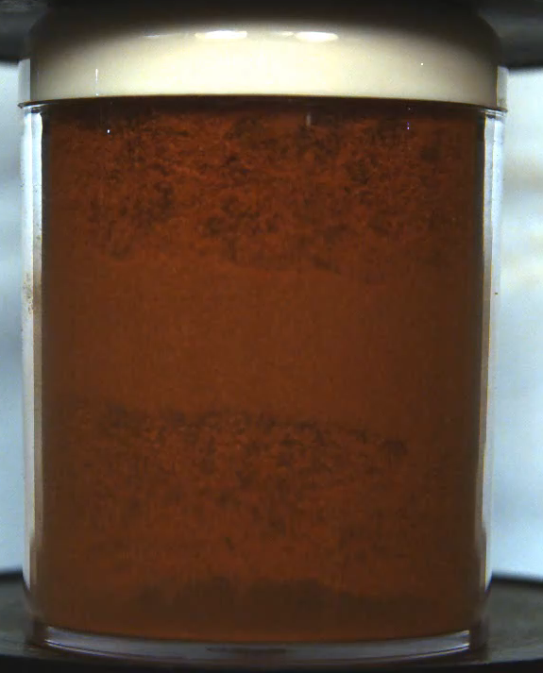
Headspace In Practice – Elastic Particles
Engagement with the Second Transducer is Affected by Adjusting Acceleration and Headspace
Reduced
Headspace
Power Density Increase From Engaging Both Transducers
Large
Headspace

Slide 12
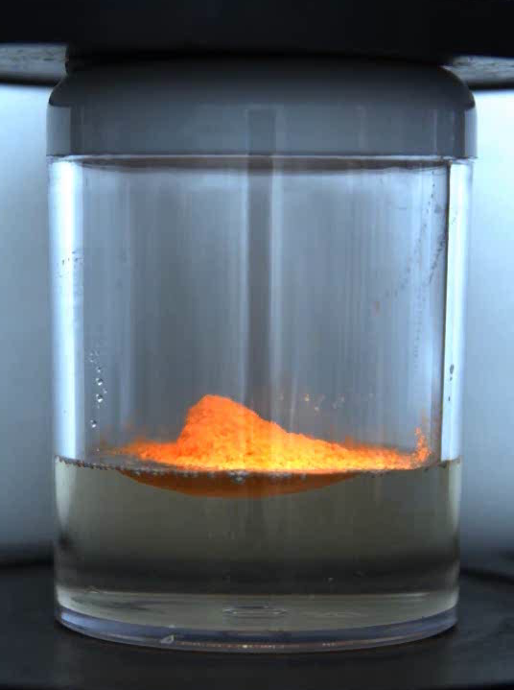
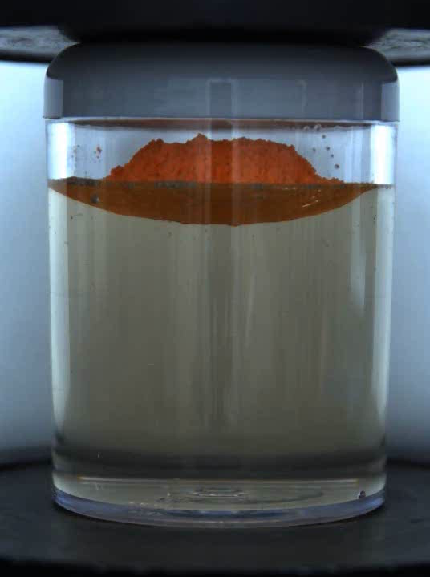
Headspace in Practice - Paste
Engagement with the second transducer can be critical to paste mixes

Slide 13
Increasing Transducer Contact
Reduce Headspace to engage with 2nd transducer
Increasing the Vessel’s Aspect Ratio

Slide 14
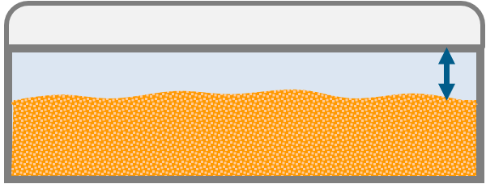
Headspace and Process Scaling
Increasing Transducer contact and Material being mixed

Slide 15
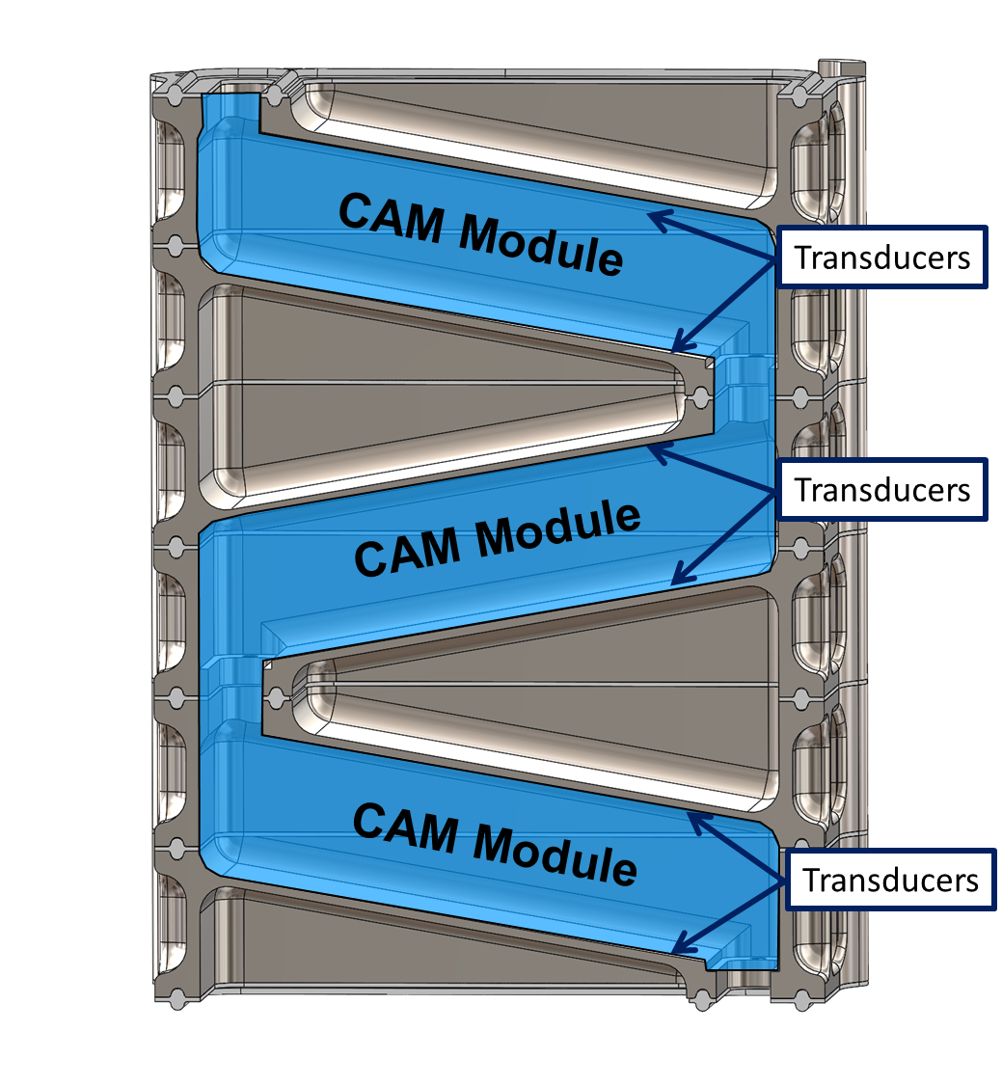
Continuous Acoustic Mixing
The CAM Stack Construction Reduces Headspace and increases transducer contact by Using Multiple Transducers
Transducers
Transducers
Transducers

Slide 16
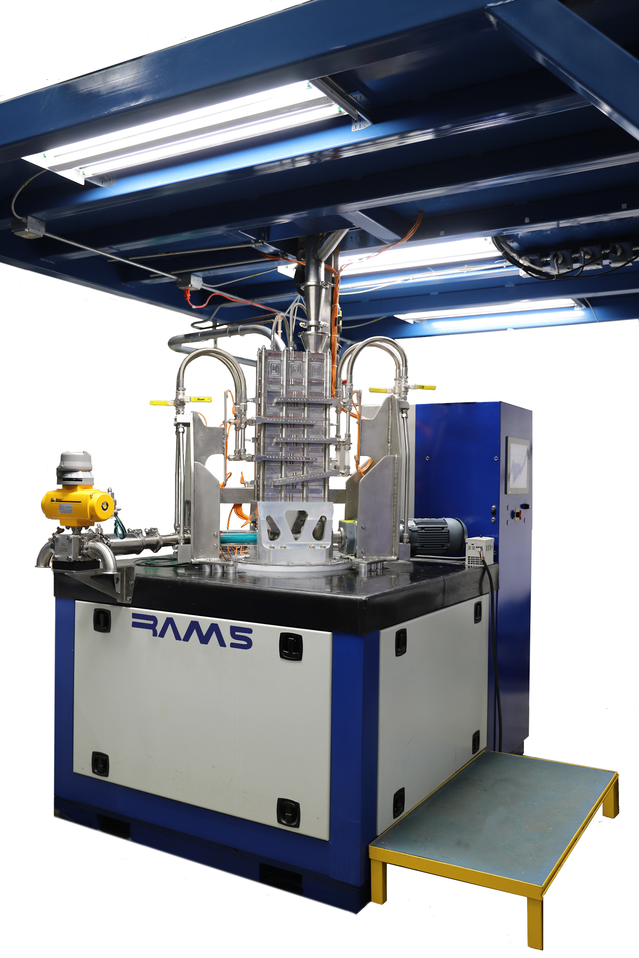
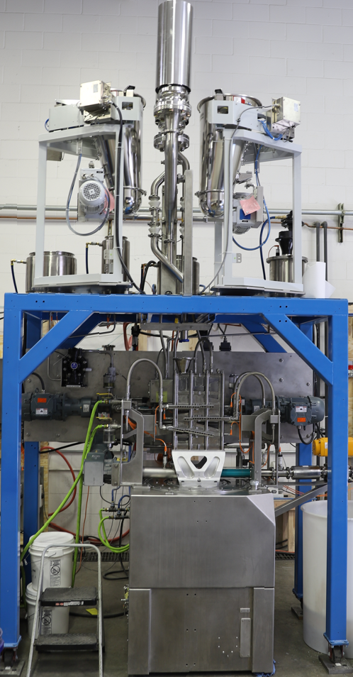
Continuous Acoustic Mixing
The CAM Stack setup is available for both RAM5 and OmniRAM mixers

Slide 17
Summary
Solid Particle Collision Intensity Increases with Increased Acceleration and Transducer Contact
Headspace Influences Mixing Intensity
  Particles more distance from the transducer see reduced impact forces
  Engaging a second transducer improves mixing performance
CAM Stack is an option for increasing transducer contact for larger mix quantities

Slide 18
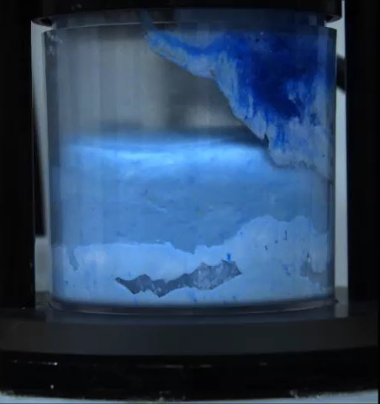
Dual Transducer - Paste

